Slide 1

Roll the dice and get it right Cidalia & Yener
Coding

Slide 2
Aim: writing a program that simulates rolling a dice
When the program runs, it randomly choose a number between 1 and 6 and print
It should then asked you if you would like to roll again.
For the average of die and minimum of 1 and maximum of 6.
Want a function that randomly grabs a number within that range and prints it.
Concepts to keep in mind:
Random
Integer
Print
While loops

Slide 3
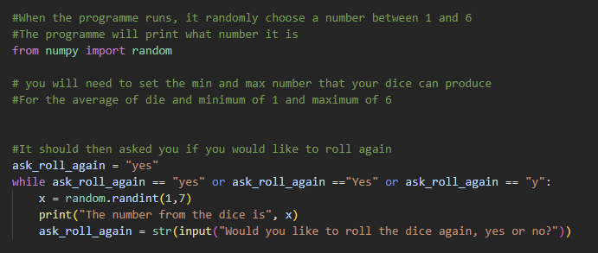
Coding

